Slide 1
Project 2nd Review
VIRTUAL TRAFFIC POLICE

Slide 2
Project Guide Details
Name: MAUSUMI GOSWAMI
Associate Professor
Department of Computer Science
Email: mausumi.goswami@christuniversity.in

Slide 3
Agenda
Abstract
Introduction
Scope of the Project
Analysis of the Project
Literature Survey
Software Requirements
Status of implementation details
References

Slide 4
Abstract
In these present days violation of traffic rules is increasing drastically.
There is need to be control of it in order to avoid frequent accident.
Virtual traffic police aims at help controlling of traffic rules using number plate detection and detection of motorcyclists without helmet.
Number plate recognition process uses image processing technology.
Detection of motorcyclist basically uses the convolutional neural network(CNN).

Slide 5
Introduction
In this project number plate detection is simply the ability to automatically extract and recognition a vehicle number plates characters from the image.
This system contains a camera that has the capability to grab an image and to find location of number in the image and then extract characters from character recognition tool.
Since motorcycles are affordable and a daily mode of transport rules must be strict in order to avoid any accidents. As helmet is mandatory as per traffic rules violation of which attract heavy fines.
This system using convolutional neural network(CNN) instead of hand crafted feature, to improve the classification performance.

Slide 6
EXISTING SYSTEM
Manually police can check the traffic violation.
We can not get alert.
No number plate based fine.
At a time we can pay the money once police has caught vehicle.
No Automated system.

Slide 7
PROPOSED SYSTEM
Number plate recognition for each traffic violation.
Police person is not required everywhere to collect the fine
If any traffic violation occurs immediately send alert message to authority.

Slide 8
Scope of the project
To find the most efficient way to recognize the registration information from the digital image (obtained from the camera)
First step is the license plate localization, regardless of the license-plate size and orientation.
The second step is the segmentation of the characters.
last step is the recognition of the characters from the license plate.
The process of character recognition consists of steps like Image processing, Defragmentation, Resizing and Character localization

Slide 9
Literature survey
In this paper [1], D. Doermann, J. Liang, H. Li set a framework to recognize the motorcyclists who are damaging the helmet laws, a framework utilizing picture handling and convolutional neural system is executed. The framework comprises of motorbike recognition, head protector versus no helmet grouping and motorbike number plate acknowledgment. The motorbikes are distinguished utilizing the element vector HOG. When the motorbike is recognized, by methods for convolutional neural system, it is resolved whether the motorcyclist is wearing a helmet or not. In the event that the motorcyclist is distinguished without helmet at that point the tag of the cruiser is recognized utilizing tesseract OCR.
In this paper [2] Jian Liang, David Doermann, discussed about the availability of high performance and low-priced digital imaging has created a tremendous opportunity for traditional screening for document image. cameras attached traditional scanner-based camera-based document analytics provide us with a good reference but they cannot be directly on camera captured images. They present a survey of application domains, technical challenges, and solutions for the analysis of documents captured by digital cameras.

Slide 10
In this work [3] Record picture recovery is a strategy utilized for looking through unsorted pictures of archives to locate the ones which are applicable for a given errand. In the previous barely any year’s workplaces and associations kept up their reports in printed structure, as the volume of printed archives were expanded, they experienced issues like space to keep them also, looking of specific archive. Printed reports are filtered trying to move towards a paperless office and are put away as pictures. Because of the advances in data innovation and monetary attainability of making a huge database of report picture has left a colossal requirement for vigorous approaches to get to the data. Numerous procedures have been created to give a proficient and powerful route for recovering and arranging these report pictures in the writing.
In this work, [4] a Non-Helmet Rider discovery framework is constructed which endeavours to fulfil the robotizing of recognizing the criminal traffic offense of not wearing protective helmet and removing the vehicles number. The fundamental rule included is Object Detection utilizing Deep Learning at three levels. The articles distinguished are individual, cruiser/sulked from the start level utilizing YOLOv2, protective cap at second level utilizing YOLOv3, License plate at the last level utilizing YOLOv2. At that point the number enrolment is extricated utilizing OCR (Optical Character Acknowledgment). Every one of these procedures are exposed to predefined conditions and limitations, particularly the tag number extraction part. Since, this work accepts video as its info, the speed of execution is significant. We have utilized above said procedures to construct an all-encompassing framework for both cap recognition and licence plate number extraction.

Slide 11
HARDWARE AND SOFTWARE REQUIREMENTS
Hardware:
Laptop
Camera
Raspberry pi
Software's:
OpenCV 2.1 is compatible with VC++ 2008 and VC++ 2010
Python
Noobs os

Slide 12
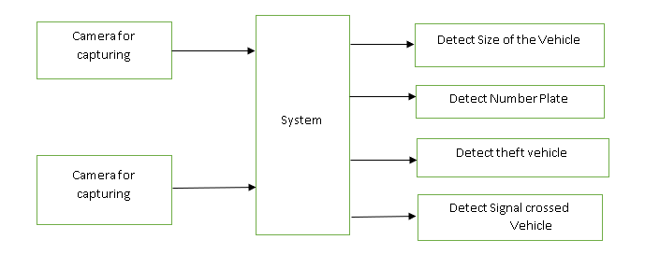
Design

Slide 13
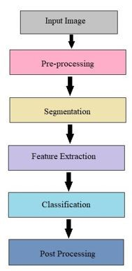
CNN(Convolution Neural Network

Slide 14
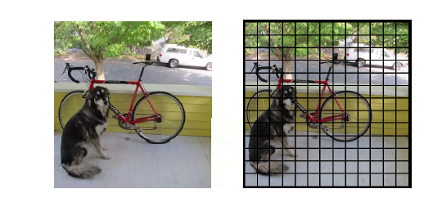
YOLO(You Only Look Once)
YOLO divides input image into SxS grid
If the centre of an object falls inside a grid cell, that grid cell is responsible for detecting the object

Slide 15
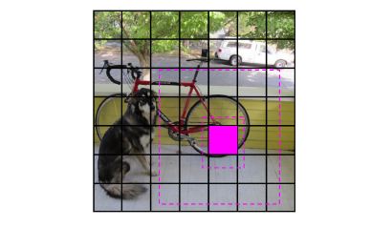
YOLO(You Only Look Once)
Each grid cell predicts B bounding boxes and confidence scores for these boxes
Confidence of box being accurate and box containing an object

Slide 16
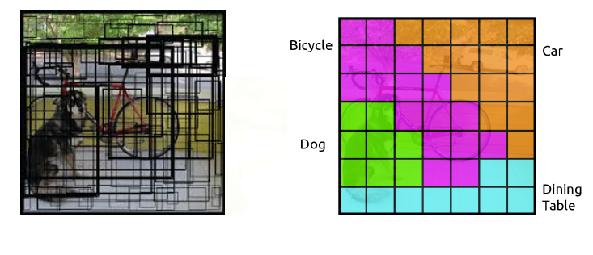

Slide 17
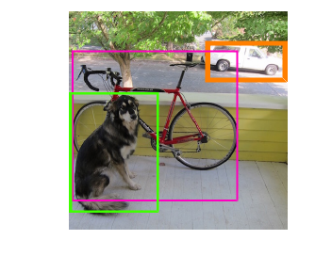
YOLO(You Only Look Once)
The conditional class probabilities and confidence of predicted bounding boxes are multiplied
For each predicted box, class specific confidence scores
Confidence of predicted box fitting the object and object belonging to that class

Slide 18
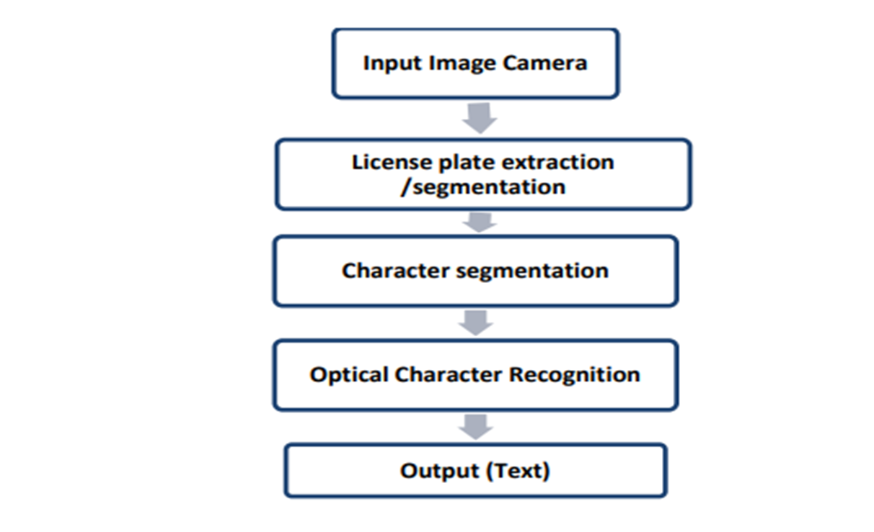
OCR(Optical Character Recognition

Slide 19
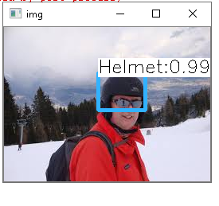
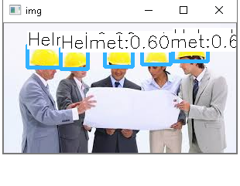
Screenshots

Slide 20
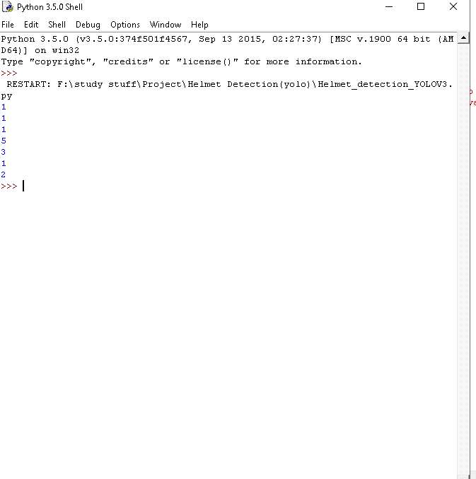

Slide 21
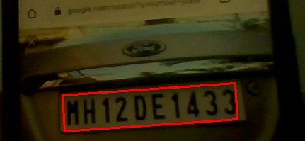



Slide 22
Conclusion
Detects and reads license plates automatically 24*7 in real time
High accuracy for heterogeneous number plates.
Simultaneous Multi-lane processing.
Engine capable for detecting and recognizing different dimensions, contrast, colours, of number plate with variety of character font & styles.
.

Slide 23
REFERENCES
[1] D. Doermann, J. Liang, H. Li, Progress in camera-based document image analysis, Proc. of the 7th ICDAR, Page(s)606-616, 2003.
[2] J. Liang, D. Doermann and H. Li, Camera-based analysis of text and documents: a survey, Int. Journ. onDocu. Anal. andRecog., vol. 7(2-3), Page(s) 84-104, 2005.
[3] T. Kazutaka, K Koichi and I. Masakazu, Real-Time Document Image Retrieval on a Smartphone, IAPR International Workshop on Document Analysis Systems, DAS 2012.
[4] T. Chattopadhyay, B. B. Chaudhuri, R. Jain, , A Novel Low Complexity TV Video OCR System, Int. Journ. onDocu. Anal. andRecog., vol. 7(2-3), Page(s) 84-104, 2005.
[5] H. Tin Kam, H S Baird, Perfect Metrics, IAPR 2nd ICDAR, 1993.
[6] “Implementing Lane Departure Warning System on Raspberry Pi”, University Tunku Abdul Rahman, May 2016, [Online] Available: www.eprints.utar.edu.my/ 1950/1/CN-2016-1308318-1.pdf [Accessed 20-JULY-2016].
[7] “A Real-Time Vision System for Night time Vehicle Detection and Traffic Surveillance”, IEEE transactions on industrial electronics, Volume58, No-5, May 2011, [Online] Available: https://ir.nctu.edu.tw/bitstream/ 11536/8964/1/000289478000054.pdf [Accessed: 18-July2016].
[8] “Morphological Image Processing Approach of Vehicle Detection for RealTime Traffic Analysis”, Science International Journal of Computer Science and Engineering, Volume-2, Issue-5, May 2014. [Online] Available: http : //www.ijcseonline.org/pubpaper/IJCSE − 00312.pd f[Accessed : 14 − JULY − 2016].

Slide 24
[9] “Development of an automated Red Light Violation Detection System (RLVDS) for Indian vehicles”, , IEEE National Conference on Computing and Communication Systems, COCOSYS-09, CS11 [Online] Available:https : //arxiv.org/ftp/arxiv/papers/1003/1003.6052.pd f[Accessed : 14 − JULY − 2016]
[10] Amey Narkhede , Vikrant Nikam and Akshay Soni, Automatic Traffic Rule Violation Detection and Number Plate Recognition, IJSTE - International Journal of Science Technology and Engineering — Volume 3 — Issue 09 — March 2017 ISSN (online): 2349-784X.
[11] “Algorithmic and Mathematical Principles of automatic Number Plate Recognition Systems”,Ondrej Martinsky, BRNO University Of Technology, 2007.
[12] Nourdine Aliane , Javier Fernandez , Mario Mata, Sergio Bemposta A System for Traffic Violation Detection , ISSN 1424-8220 www.mdpi.com/journal/sensors, 24 November 2014.
[13] C. Vishnu, Dinesh Singh, C. Krishna Mohan and Sobhan Babu Detection of Motorcyclists without Helmet in Videos using Convolutional Neural Network , https://www.researchgate.net/publication/320797547 (Online), May 2017.
[14] Emy Barnabas, AmrithaB.J Helmet Detection and License Plate Recognition Using CNN , IOSR Journal of Engineering (IOSRJEN) ISSN (e): 2250-3021, ISSN (p): 2278-8719 Vol. 09, Issue 6 (June. 2019).
[15] A.Ushma, Prof. Dr. A.R. Mohamed Shanavas, Object Detection In Image Processing Using Edge Detection Techniques , IOSR Journal of Engineering (IOSRJEN) ISSN (e): 2250-3021, ISSN (p): 2278-8719 Vol. 04, Issue 03 (March. 2014).
[16] R Handaric, D Floroian, An Image Recognition Software tool For Car Identification Based On License Plate, Bulletin of the Transilvania University of Bras¸ov Series I: Engineering Sciences • Vol. 5 (54) No. 1 - 2012

Slide 25
THANK YOU

